Slide 1
Implementation of Land Reforms
Presented by:
Ashwina Poudel
Bibek Sunwar

Slide 2
Introduction
Land Reforms refer to reforms related to Land ownership, Land holdings and landlord-tenant relationships.
Land reforms aim at redistributing ownership holding from the viewpoint of social justice, and reorganizing operational holdings from the viewpoint of optimum utilization of land.

Slide 3
Objectives
Increase Agricultural Productivity
Social Welfare
Economic Growth
To abolish the Intermediaries
To prevent the exploitation of the tenants by the landlords

Slide 4
Government changes regarding to land
Abolition of Intermediaries
Regulation of rent
Cooperative farming
Celling on Landholdings

Slide 5
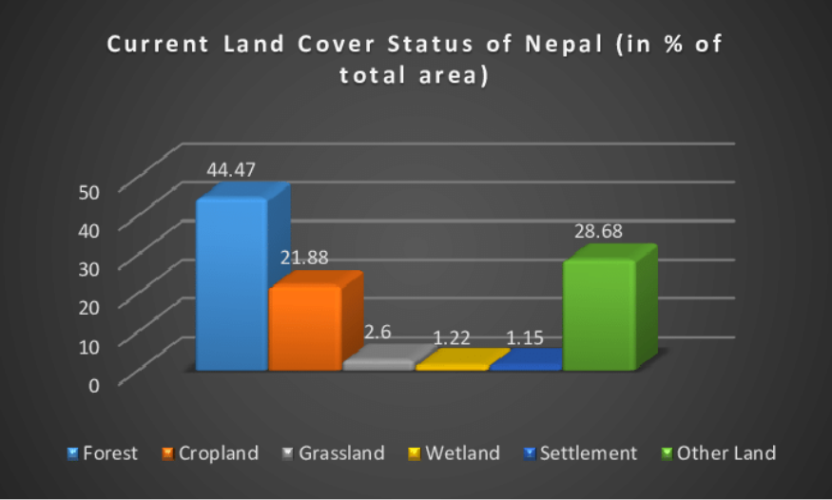
Status of Land Management in Nepal
According to the data of Forest Research and Training Center ,2020

Slide 6
Issues facing equitable land ownership
The real picture of land ownership is not known.
The rule of (land) law has been seriously undetermined through repeated failure to enforce the legal land reform provisions enacted, permitting evasion to run unchecked.
Ordinary land owners have no control over their land relations.
Polarization & exploitation continues – and resentment grows.

Slide 7
Land use Norms and Standards in Planning Practice
Planning Norms and Standards in 2020.
Table 1. Types of land use for Market Center.
S.No. | Broad Classification | Sub-classification
1. | Natural Resources Area (60%) | Agricultural forest/Community forest/Water bodies
2. | Settlement Promoted Area (40%) | Mixed (Residential cum Commercial)/Residential/Institution al (Office complexes)/Industrial (Agricultural initial processing industries that are linked to the industries of the cities)

Slide 8
S.No. | Broad Classification | Sub-classification
1. | Natural Resources Area (60%) | Urban agriculture/Water bodies/Open spaces/Public land
2. | Settlement Promoted Area (40%) | Mixed(Residential cum Commercial)/Residential/Rural residential/Commercial/Institutional/ Industrial (Production with heavy processing)/Recreational/Park
Table 2. Types of land use for City.

Slide 9
CONCLUSION
Land reform is successful in Nepal because government were committed to the policy of land reform and has the equality in landholdings.
The local governments have attained required technical and institutional capacity with long-term vision for spatial development of their land resources.

Slide 10
THANK YOU!

